Slide 1

DELE CA1 Part B
Name: Hong Zheng Jie Randal
Class:DAAA/FT/2B/21
Admin No: P2309248

Slide 2
Overview of the Workflow
1. Project Configuration
2. EDA & Preprocess Data
3. Model Training
4. Model Evaluation
Import libraries
Load data
Language analysis
Score analysis
Review analysis
Sentiment analysis
Tokenization
Padding
Train-test-validation split
Class weights
Build models with different layers, optimizers, regularization etc.
Ensure model is not overfitting/underfitting by using plot functions of accuracy and loss per epoch
Choose best model from the val loss and val accuracy
Test and score with test data
Model summary
Prediction analysis
-

Slide 3
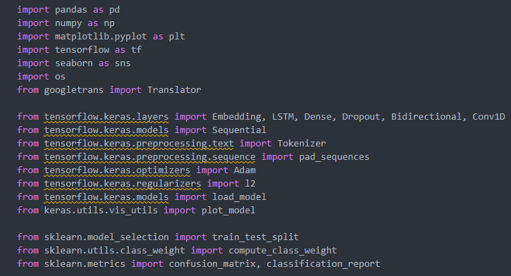
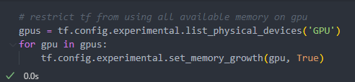

1. Project Configuration
Import all required modules
Ensure GPU is being used for model training
Set random seed for reproductibility

Slide 4
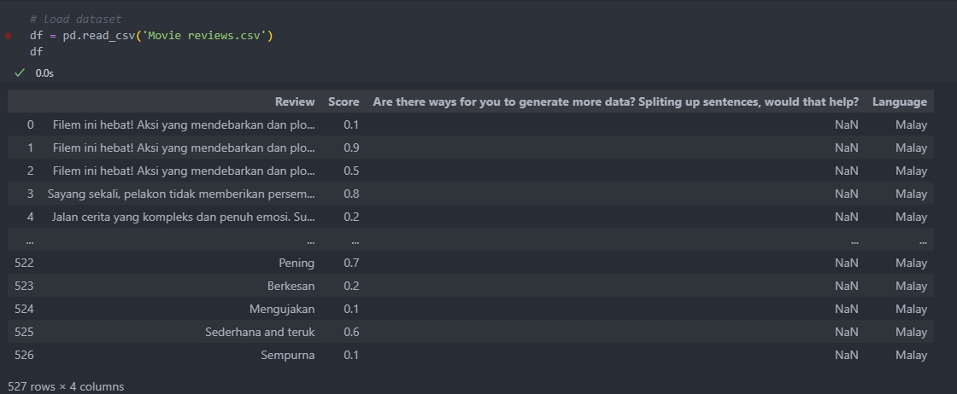

2. Exploratory Data Analysis
Load dataset
Remove redundant column

Slide 5
2. Exploratory Data Analysis
We can either do classification or regression to tackle this problem
I have chosen classification (either positively sentimented or negatively sentimented) rather than regression (predicting the score)
The model will only have to predict two classes rather than a continuous value
May improve the model's performance

Slide 6
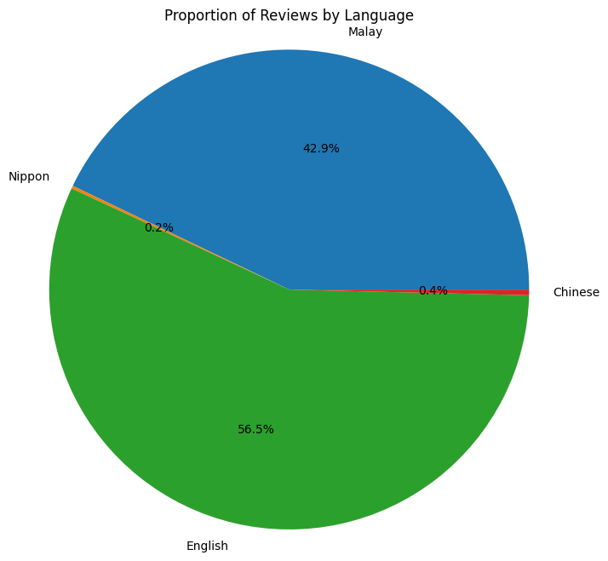
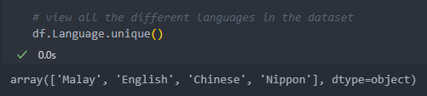
2. Exploratory Data Analysis - Language
View all different types of languages in the dataset
Imbalanced in the type of langauge used
Majority of the dataset is in English, followed by Malay

Slide 7
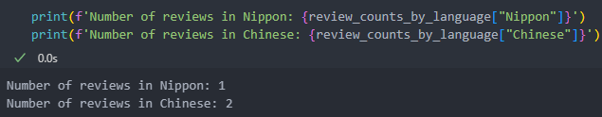
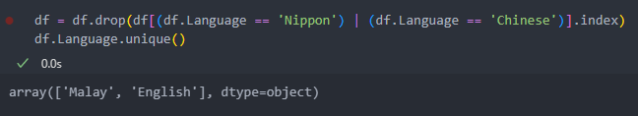
2. Exploratory Data Analysis - Language
View number of reviews for the minority languages
Chinese and Japanese are not as common in the dataset
Remove the Chinese and Japanese reviews from the dataset

Slide 8
2. Exploratory Data Analysis - Language
We have 2 options to deal with the languages in the dataset:
1. Translate the Malay reviews to English
2. Split the dataset into their respective languages and train 2 separate models for each language
Two separate models for each language is computationally expensive
Smaller dataset to train
Hence opt for the first option

Slide 9
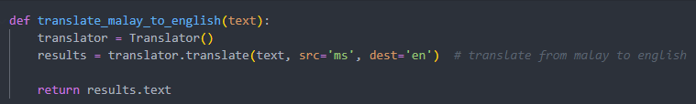
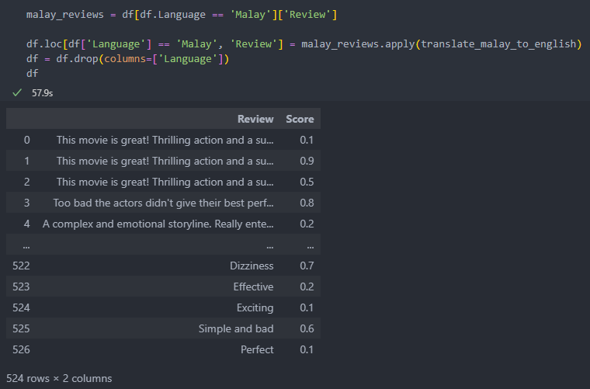
2. Exploratory Data Analysis - Language
Translate with Google Translate API

Slide 10
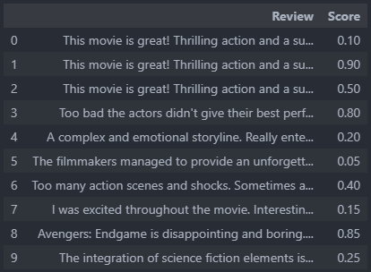
2. Exploratory Data Analysis - Score
If we look at row 7, the review is positive. The score is 0.15 (low)
If we look at row 3, the review is negative. The score is 0.80 (high)
We can assume that the lower the score, the more positive the review is

Slide 11
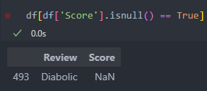
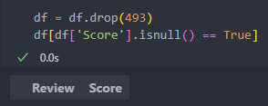
2. Exploratory Data Analysis - Score
Since there is only 1 review where the score is missing, we can just remove this review from the dataset

Slide 12
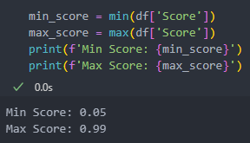
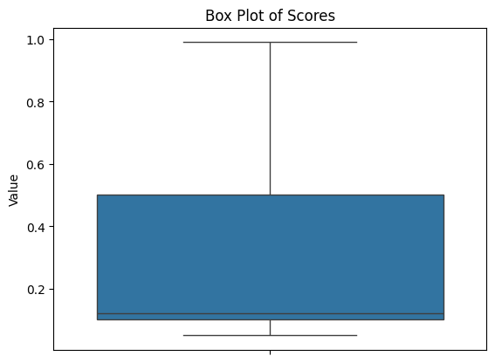
2. Exploratory Data Analysis - Score
Analyse score distribution
Dataset has more positive reviews than negative reviews
Median score of about 0.1
Dataset is biased towards positive reviews

Slide 13
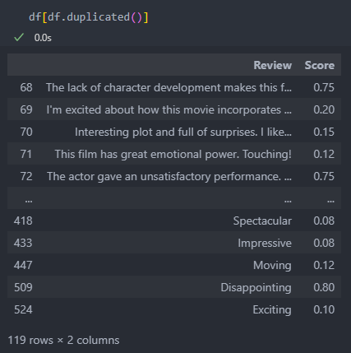
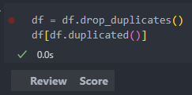
2. Exploratory Data Analysis - Reviews
Many duplicated rows
Remove from dataset

Slide 14
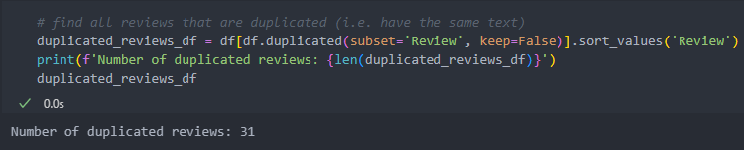
2. Exploratory Data Analysis - Reviews
Many duplicated reviews
Manually go through the reviews and determined their sentiment
If the reviews' score matched the sentiment, calculate the average scores and update it to the first review
Drop the other reviews
If the reviews' score did not match the sentiment, select based on the score closest to the sentiment
Drop the other reviews

Slide 15
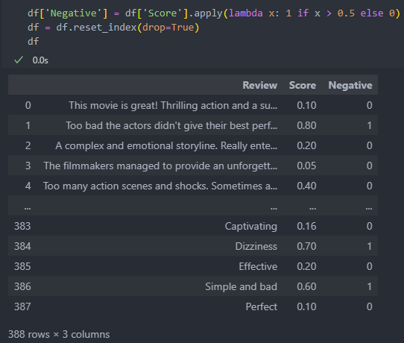
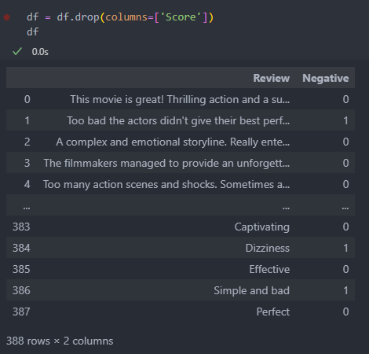
2. Exploratory Data Analysis - Sentiment
Split reviews into sentiments according to score
Remove score column

Slide 16
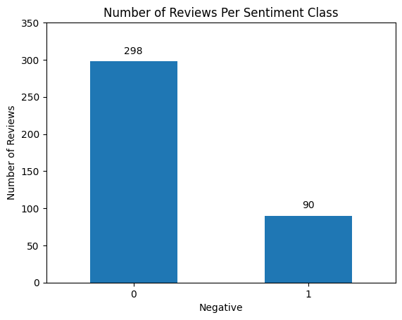
2. Exploratory Data Analysis - Sentiment
View sentiment distribution
Huge class imbalance in the dataset
Number of reviews for each class are fairly little
May not be enough to train a model with good performance
Split existing reviews into more reviews to generate more data by '.' or '!'

Slide 17
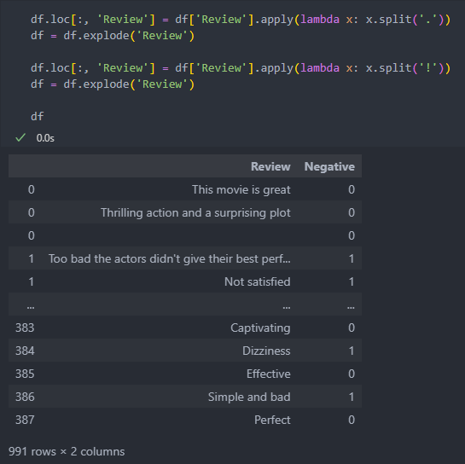
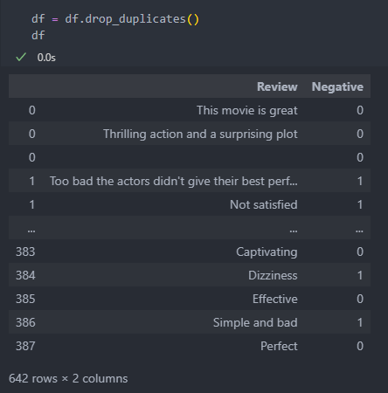
2. Exploratory Data Analysis - Sentiment
Generate more reviews
Remove duplicates from generating more reviews

Slide 18
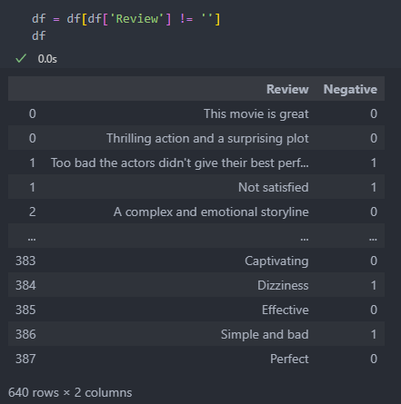
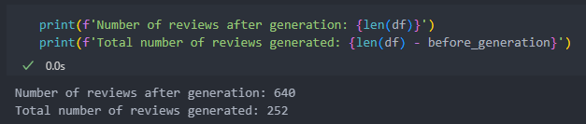
2. Exploratory Data Analysis - Sentiment
Remove blanks from generating more reviews
Generated 252 reviews

Slide 19
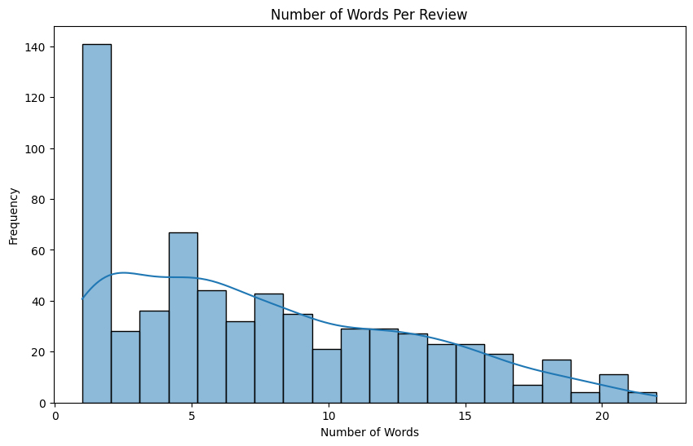
2. Exploratory Data Analysis - Sentiment
View text length distribution
Many 1 worded reviews
Model may perform better with 1 worded reviews than others

Slide 20
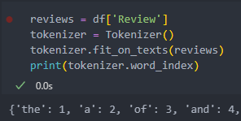
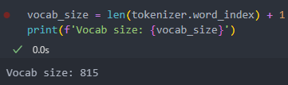
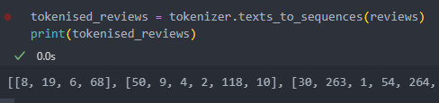
2. Exploratory Data Analysis – Tokenization
Tokenize reviews
Get vocab size
Convert to sequence

Slide 21
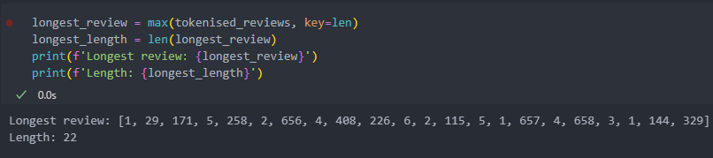
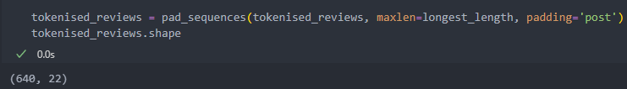
2. Exploratory Data Analysis – Padding
Add 0s behind every sequence

Slide 22
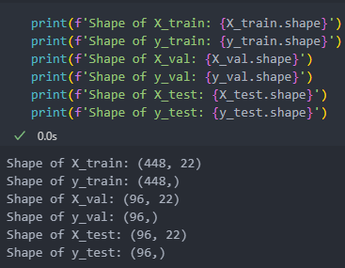
2. Exploratory Data Analysis – Train-Test-Validation Split
70-15-15 split for the train, test and validation datasets respectively
Due to lack of data
We will also use stratified sampling to ensure that the distribution of the classes are the same across all datasets as the dataset is imbalanced

Slide 23
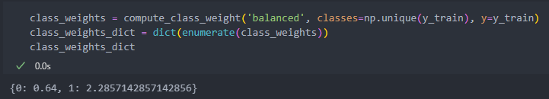
2. Exploratory Data Analysis – Class Weights
Use class weights to counter class imbalance
Give more weights to minority class
Less weights to majority class

Slide 24
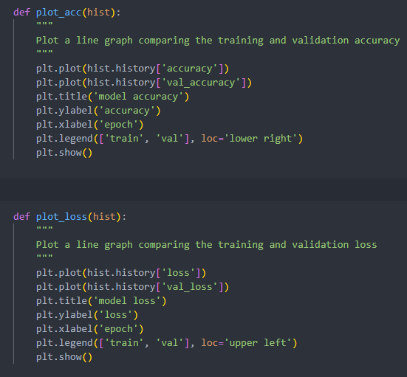
3. Model Training
We will be plotting the accuracy and loss plot many times to view our model’s performance
Create a function to reduce redundancy

Slide 25
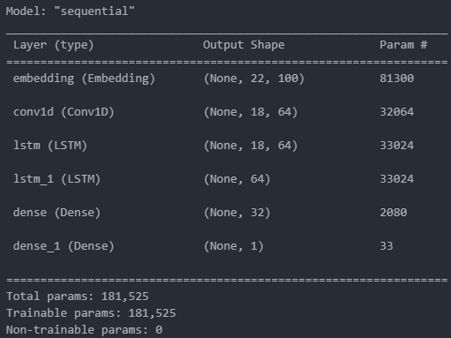
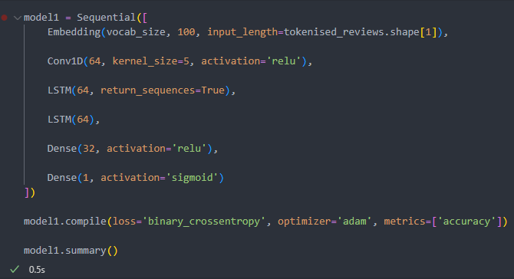
3. Model Training
As this will be our first model, I will not make the model too complicated with too many layers

Slide 26
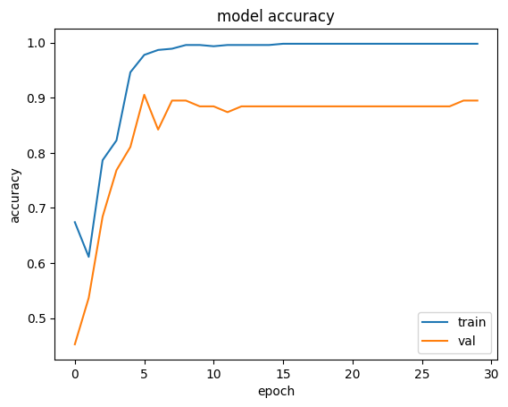
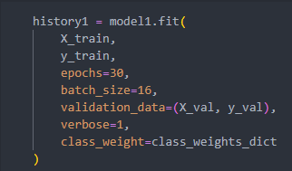
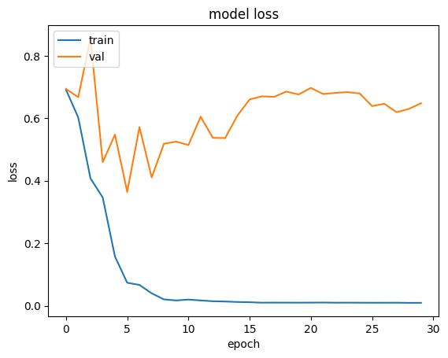
3. Model Training
Val accuracy is high and stays constant at around 0.9
Val loss is high and is increasing

Slide 27
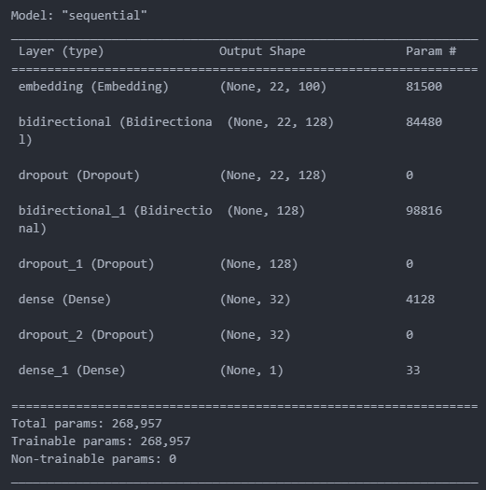
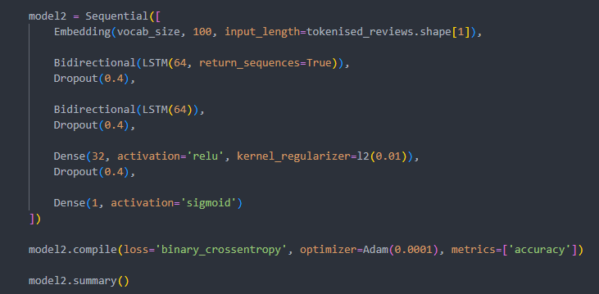
3. Model Training
We will try to add more layers and lower optimizer learning rate to see if it improves the model's performance

Slide 28
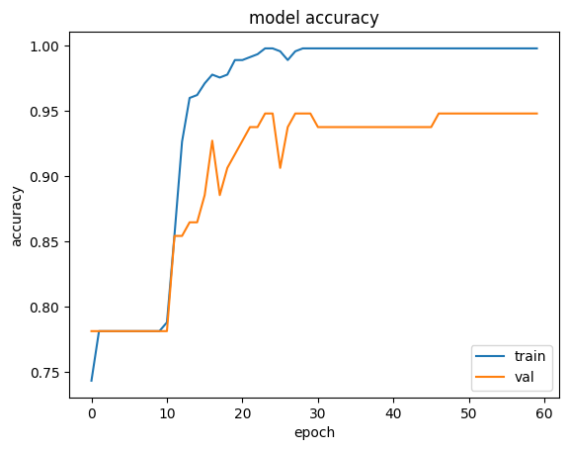
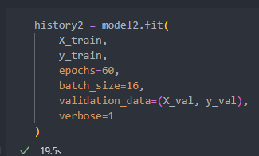
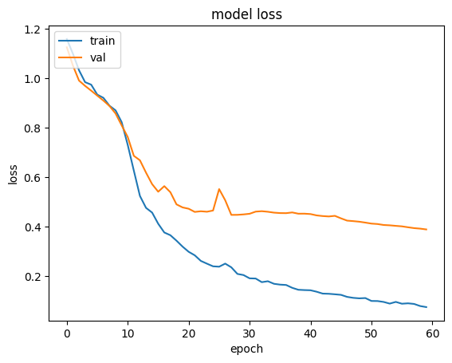
3. Model Training
Although val accuracy fluctuates, it starts to smoothen out at the later epochs
Val loss also decreases as the epochs increase
As the model's performance is good, we shall choose this model as our final model

Slide 29

4. Model Evaluation
Accuracy: 88.5%
Loss: 0.71

Slide 30
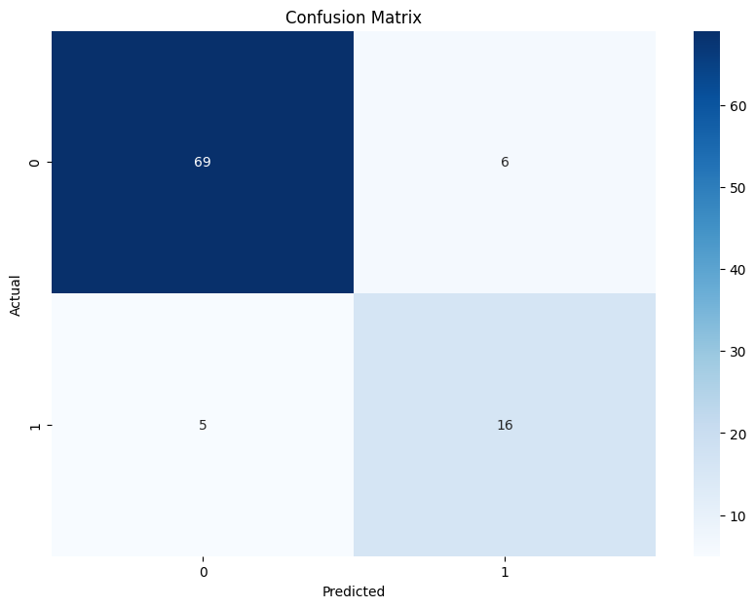
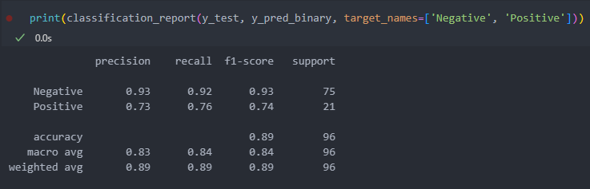
4. Model Evaluation
Model performs well overall especially on the Negative class
Due to imbalance in the classes (having more negatives)
Room for improvement in predicting the Positive class such as resampling
This could be due to class imbalance or the model not learning the Positive class features as effectively even with class weights

